Slide 1

Mini Project-I (K24MCA18P) Odd Semester Session 2024-25
SHOPGUIDE
ASHWANI KUMAR KATIYAR and 2426MCA2464
ANUP KUMAR MAHTO and 2426MCA1305
BISHOP TYAGI and 2426MCA1718
Project Supervisor:
Divya Singhal
Assistant Professor

Slide 2
Content
Introduction
Literature Review
Objective of the Project
Technology
Hardware Requirements
Software Requirements
Modules
Workflow
Reports
Notes:
Font Styles: Times New Roman + Font Size: 25

Slide 3
Introduction
Local Guide :
The Local Guide is an innovative platform designed to connect consumers with shops and services in their local area
The website serves as a directory for various types of businesses including
grocery stores,
medical shops,
gyms,
salons,
hardware stores,
electronics shops
Notes:
Font Styles: Times New Roman + Font Size: 25

Slide 4
Literature Review
Objective:
Local Commerce and Digital Empowerment
The Local Guide extends this premise by offering a digital platform tailored to local businesses
Price Transparency and Consumer Decision-Making
Research shows that when consumers are provided with clear pricing and product comparisons, they are more likely to trust the platform
Notes:
Font Styles: Times New Roman + Font Size: 25

Slide 5
Literature Review (Contd.)
Online Business Directories
many existing platforms focus more on business discovery rather than offering detailed insights into product pricing or facilitating direct product comparisons
Bridging the Gap Between Online and Offline Commerce
The Local Guide aligns with this concept by providing detailed shop and product information, helping users make informed decisions before visiting physical stores.
Notes:
Font Styles: Times New Roman + Font Size: 25

Slide 6
Objective of the Project
LocalGuide is a Versatile and user- friendly platform .
To Bridge the Gap Between Consumers and Local Businesses
To Enhance Local Market Transparency
To Support Small Businesses in the Digital Economy
To Improve the Local Shopping Experience
A list of all shops , categorized based on various category (location, type , services, etc).
Notes:
Font Styles: Times New Roman + Font Size: 25

Slide 7
Technology (Hardware Requirements)
Minimum Requirements:
Processor: Intel Core i3 or AMD Ryzen 5
RAM: 4GB
Storage: 128GB
Operating System: Windows 7 and above, macOS .
Internet: Stable internet connection
Additional Tools:
IDE/code Editor: VS Code
Database Manger: MySQL
Version Control: Git and GitHub
Browser: Chrome, Firefox
Notes:
Font Styles: Times New Roman + Font Size: 25

Slide 8
Technology (Software Requirements)
Frontend:
HTML, CSS , JavaScript
Backend:
Firebase
Database:
SQL.
Hosting:
AWS, digitalOcean.
Notes:
Font Styles: Times New Roman + Font Size: 25

Slide 9
Modules
User Module:
Allow Users to login and allow to explore shops.
Enable users to search for shop based on shop type,location .
Allow user to leave review for shops to improve community engagement
Shop Owner Module:
Shop owners can add and edit shop details such as contact info or operating hours.
Allow shop owners to promote their shops .
Notes:
Font Styles: Times New Roman + Font Size: 25

Slide 10
Modules
Shop Listing and Search Module:
Maintain a dynamic database for shops, including their categories, location, and services.
Reviews and Rating Module:
Allow users to write detailed review and assign rating to shop they have visited.
Notification Module:
Notify shop owners about users needs.
Notes:
Font Styles: Times New Roman + Font Size: 25

Slide 11
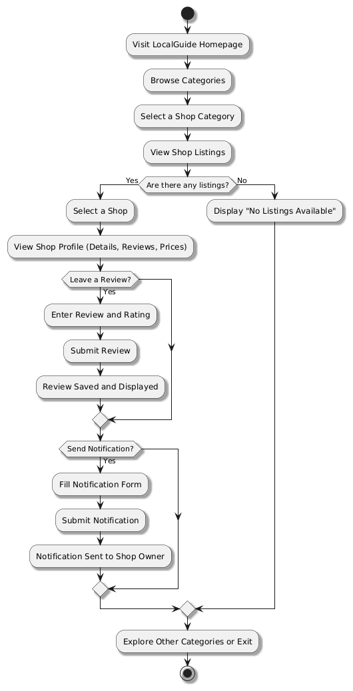
Workflow/Gantt Chart
Notes:
Font Styles: Times New Roman + Font Size: 25

Slide 12
References
1. W3 School
2. Youtube (codewithharry)
Notes:
Font Styles: Times New Roman + Font Size: 25

